Slide 1
Solving the Conjugate Gradient Method in a SpiNNaker machine
By Alexandros Oikonomou
Supervisor: Jeff Reeve

Slide 2
Problem
Solve the aforementioned algorithm and reduce the complexity of its most expensive operations

Slide 3
SpiNNaker Machine
Inspired by the biology of the human brain
At the core of the machine we have the SpiNNaker chip
Basics of the chip are the application cores and the router
Packets only contain source address
Programmer writes event handlers which are executed when certain events take place

Slide 4
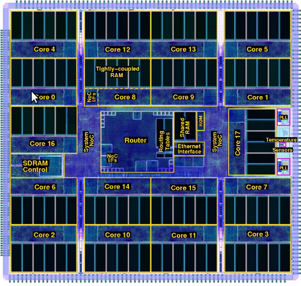
SpiNNaker Chip

Slide 5
Conjugate Gradient Method
Solution to systems of linear equations
Derived from quadratic form
Chooses step for x based on p. And p chooses next step based on its conjugate gradient

Slide 6
Solution
One element of the input matrix A and vectors x and b is inserted to one core of the SpiNNaker chip

Slide 7
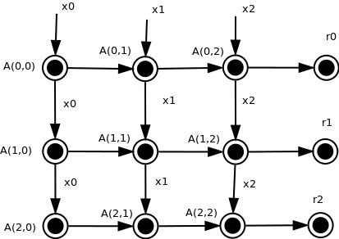
Example

Slide 8
Solution(b)
The operation that is to be done in each core is to be defined by OpCodes(Operation Codes)
In this solution, I had a vector of queues of OpCodes(unsigned integers) that would determine what operation to do next in each core
Each core would have different OpCodes and the queue would contain the integers.
The vector acted as a key to determine from which type of core a packet was sent from

Slide 9
Implementation
SpiNNaker does not support libraries for queues and vectors, so a custom made implementation for the aforementioned data structure was made by using an array.

Slide 10
Results
The design and implementation created in this project worked for any size matrix.
Eventually, the complexity was reduced to O(4) + log2 (N) + O(4) for matrix-vector multiplication and O(4) for dot products.
Worked successfully for both simulators of the SpiNNaker machine

Slide 11
The End
Any Questions?

